Slide 1
Chapter 3
Describing Syntax and Semantics

Slide 2
Chapter 3 Topics
Introduction
The General Problem of Describing Syntax
Formal Methods of Describing Syntax
Attribute Grammars
Describing the Meanings of Programs: Dynamic Semantics
Copyright © 2015 Pearson. All rights reserved.
1-<number>

Slide 3
Introduction
Syntax: the form or structure of the expressions, statements, and program units –
i.e. Java : while (boolean_expr) statement
Semantics: the meaning of the expressions, statements, and program units –
i.e. Java : that when the current value of the Boolean expression is true, the embedded statement is executed. Then control implicitly returns to the Boolean expression to repeat the process. If the Boolean expression is false, control transfers to the statement following the while construct
Copyright © 2015 Pearson. All rights reserved.
1-<number>

Slide 4
Introduction
Syntax and semantics provide a language’s definition
  Users of a language definition
    Other language designers
    Implementers
    Programmers (the users of the language)
    Note: one problem with describing a language is the diversity of the people (users) who must understand the description.
Copyright © 2015 Pearson. All rights reserved.
1-<number>

Slide 5
The General Problem of Describing Syntax: Terminology
A sentence is a string of characters over some alphabet
A language is a set of sentences
The syntax rules of a language specify which strings of characters from the language’s alphabet are in the language.
Copyright © 2015 Pearson. All rights reserved.
1-<number>

Slide 6
The General Problem of Describing Syntax: Terminology
A lexeme is the lowest level syntactic unit of a language (e.g., *, sum, begin)
Broken down into groups: variables, methods,classes. Each group is an identifier or token
A token is a category of lexemes (e.g., identifier)
Copyright © 2015 Pearson. All rights reserved.
1-<number>

Slide 7
The General Problem of Describing Syntax: Terminology
Java statement: index = 2 * count + 17;
The lexemes and tokens of this statement are
Lexemes Tokens
index identifier
= equal_sign
2 int_literal
* math_op
count identifier
+ math_op
17 int_literal
; semicolon
Copyright © 2015 Pearson. All rights reserved.
1-<number>

Slide 8
Formal Definition of Languages – two distinct ways
Recognizers
  A recognition device reads input strings over the alphabet of the language and decides whether the input strings belong to the language
  Example: syntax analysis part of a compiler
  - Detailed discussion of syntax analysis appears in
  Chapter 4
Generators
  A device that generates sentences of a language
  One can determine if the syntax of a particular sentence is syntactically correct by comparing it to the structure of the generator
Copyright © 2015 Pearson. All rights reserved.
1-<number>

Slide 9
BNF and Context-Free Grammars
Context-Free Grammars
  Developed by Noam Chomsky, a linguist not a computer scientist, in the mid-1950s
  Language generators, meant to describe the syntax of natural languages (not artificial languages, i.e. communication with computers)
  Defined two classes of languages called context-free and regular languages, turned out to be good for describing syntax of programming languages
Copyright © 2015 Pearson. All rights reserved.
1-<number>

Slide 10
BNF and Context-Free Grammars
Backus-Naur Form (1959)
  Invented by John Backus to describe the syntax of Algol 58, later modified by Peter Naur
  BNF is equivalent to context-free grammars
  Example: <assign> → <var> = <expression>
  You have two sides: LHS -> RHS
  So Left Hand Side of arrow and Right Hand Side of arrow
Copyright © 2015 Pearson. All rights reserved.
1-<number>

Slide 11
BNF Fundamentals
In BNF, abstractions are used to represent classes of syntactic structures--they act like syntactic variables (also called nonterminal symbols, or just nonterminals)
Terminals are lexemes or tokens
A rule has a left-hand side (LHS), which is a nonterminal, and a right-hand side (RHS), which is a string of terminals and/or nonterminals.
LHS and RHS separated by an arrow
Copyright © 2015 Pearson. All rights reserved.
1-<number>

Slide 12
BNF Fundamentals (continued)
Nonterminals are often enclosed in angle brackets
  Examples of BNF rules:
  <ident_list> → identifier | identifier, <ident_list>
  <if_stmt> → if <logic_expr> then <stmt>
Grammar: a finite non-empty set of rules
A start symbol is a special element of the nonterminals of a grammar
Java Assignment Example:
BNF abstraction rule : <assign> → <var> = <expression>
<var> -> a | b | c | d…… | 1 | 2 | 3…..
<expression> → <var> { (+|-) <var>} brackets explained in EBNF
Example of syntactic structure of the rule : total = subtotal1 + subtotal2
Copyright © 2015 Pearson. All rights reserved.
1-<number>

Slide 13
BNF Rules
An abstraction (or nonterminal symbol) can have more than one RHS
<stmt> → <single_stmt>
| begin <stmt_list> end
Copyright © 2015 Pearson. All rights reserved.
1-<number>

Slide 14
Describing Lists
Syntactic lists are described using recursion (if the LHS appears in the RHS)
<ident_list> → ident
| ident, <ident_list>
A derivation is a repeated application of rules, starting with the start symbol and ending with a sentence (all terminal symbols)
In a grammar for a complete programming language, the start symbol represents a complete program and is often named <program>. Example next page
Copyright © 2015 Pearson. All rights reserved.
1-<number>

Slide 15
An Example Grammar - for a small lanuage
<program> → begin <stmt_list> end
<stmt_list> → <stmt>
| <stmt> ; <stmt_list>
<stmt> → <var> = <expression>
<var> → A | B | C
<expression> → <var> + <var>
| <var> – <var>
| <var>
The language described by the grammar of Example 3.1 has only one statement form: assignment. A program consists of the special word begin, followed by a list of statements separated by semicolons, followed by the special word end. An expression is either a single variable or two variables separated by either a + or - operator. The only variable names in this language are A, B, and C.
Copyright © 2015 Pearson. All rights reserved.
1-<number>

Slide 16
An Example Derivation (basically the language grammar rules being applied)
<program> => begin <stmt_list> end
=> begin <stmt> ; <stmt_list> end
=> begin <var> = <expression> ; <stmt_list> end
=> begin A = <expression> ; <stmt_list> end
=> begin A = <var> + <var> ; <stmt_list> end
=> begin A = B + <var> ; <stmt_list> end
=> begin A = B + C ; <stmt_list> end
=> begin A = B + ; <stmt> end
=> begin A = B + C ; <var> = <expression> end
=> begin A = B + C ; B = <expression> end
=> begin A = B + C ; B = <var> end
=> begin A = B + C ; B = C end
Note: each successive string in the sequence (top to bottom in this case) is “derived”, from the previous string by replacing nonterminals with terminals.
Copyright © 2015 Pearson. All rights reserved.
1-<number>

Slide 17
Derivations
Every string of symbols in a derivation is a sentential form
A sentence is a sentential form that has only terminal symbols (the last one on above example)
A leftmost derivation is one in which the leftmost nonterminal in each sentential form is the one that is expanded
A derivation may be neither leftmost nor rightmost
Copyright © 2015 Pearson. All rights reserved.
1-<number>

Slide 18
Parse Tree
A hierarchical representation of a derivation
<program>
<stmt_list>
<stmt>
<var>
=
<expr>
A
<term>
+
<term>
<var>
const
B
Copyright © 2015 Pearson. All rights reserved.
1-<number>

Slide 19
Parse Tree
Every internal node of a parse tree is labeled with a nonterminal symbol;
Every leaf is labeled with a terminal symbol.
Every subtree of a parse tree describes one instance of an abstraction in the sentence.
Copyright © 2015 Pearson. All rights reserved.
1-<number>

Slide 20
Ambiguity in Grammars
A grammar is ambiguous if and only if it generates a sentential form that has two or more distinct parse trees
Copyright © 2015 Pearson. All rights reserved.
1-<number>

Slide 21
An Ambiguous Expression Grammar
<expr> → <expr> <op> <expr> | const
<op> → / | -
<expr>
<expr>
<expr>
<op>
<expr>
<expr>
<op>
<op>
<expr>
<expr>
<op>
<expr>
<expr>
<op>
<expr>
const
-
const
/
const
const
-
const
/
const
Copyright © 2015 Pearson. All rights reserved.
1-<number>

Slide 22
An Unambiguous Expression Grammar
If we use the parse tree to indicate precedence levels of the operators, we cannot have ambiguity (Is Java ambiguous?)
Lower in the tree, operation must be done first
<expr> → <expr> - <term> | <term>
<term> → <term> / const| const
<expr>
<expr>
-
<term>
<term>
<term>
/
const
const
const
Copyright © 2015 Pearson. All rights reserved.
1-<number>

Slide 23
Associativity of Operators
Operator associativity can also be indicated by a grammar
<expr> -> <expr> + <expr> | const (ambiguous)
<expr> -> <expr> + const | const (unambiguous)
<expr>
<expr>
<expr>
+
const
<expr>
+
const
const
Copyright © 2015 Pearson. All rights reserved.
1-<number>

Slide 24
Unambiguous Grammar for Selector
Java if-then-else grammar
<if_stmt> -> if (<logic_expr>) <stmt>
| if (<logic_expr>) <stmt> else <stmt>
Ambiguous!
- An unambiguous grammar for if-then-else
<stmt> -> <matched> | <unmatched>
<matched> -> if (<logic_expr>) <stmt>
| a non-if statement
<unmatched> -> if (<logic_expr>) <stmt>
| if (<logic_expr>) <matched> else
<unmatched>
Copyright © 2015 Pearson. All rights reserved.
1-<number>

Slide 25
Extended BNF – Called EBNF
Optional parts are placed in brackets [ ]
<proc_call> -> ident [(<expr_list>)]
In C : <if_stmt> → if (<expression>) <statement> [else <statement>]
Instead of using two rules:
<if_stmt> → if (<expression>) <statement>
|if (<expression>) <statement> else <statement>
Copyright © 2015 Pearson. All rights reserved.
1-<number>

Slide 26
Extended BNF – Called EBNF
Repetitions (0 or more) are placed inside braces { }
<ident> → letter {letter|digit}
Alternative parts (multiple choice) of RHSs are placed inside parentheses and separated via vertical bars
<term> → <term> (*|/|%) const
(instead of having three rules, one for *, one for /, and one for %)
Copyright © 2015 Pearson. All rights reserved.
1-<number>

Slide 27
BNF and EBNF – examples of EBNF cutting down the amount or rules needed
BNF
<expr> → <expr> + <term>
| <expr> - <term>
| <term>
<term> → <term> * <factor>
| <term> / <factor>
| <factor>
EBNF
<expr> → <term> {(+ | -) <term>}
<term> → <factor> {(* | /) <factor>}
Copyright © 2015 Pearson. All rights reserved.
1-<number>

Slide 28
Recent Variations in EBNF
Alternative RHSs are put on separate lines instead of vertical bar |
Use of a colon instead of arrow ->
Use of _{opt} for optional parts instead of the brackets { }
Constructor Declarator → SimpleName (FormalParameterList opt)
Use of oneof for choices instead of vertical line(s) inside parenthesies (* | / | %)
AssignmentOperator → one of = *= /= %= += -=
Copyright © 2015 Pearson. All rights reserved.
1-<number>

Slide 29
Parse Tree Example
Given BNF –
<assign> → <id> = <expr>
<id> → A | B | C
<expr> → <id> + <expr>
| <id> * <expr>
| ( <expr> )
| <id>
Show Parse Tree for: a = b + d
b = ( c * ( a + b ) )
Copyright © 2015 Pearson. All rights reserved.
1-<number>

Slide 30
End Of 3.1 – 3.3
Copyright © 2015 Pearson. All rights reserved.
1-<number>

Slide 31
Attribute Grammars
Attribute grammars (AGs) have additions to CFGs (Context Free Grammer – BNF) to describe more of the structure of a programming language
Extension to CFG
Conveniently describes certain language rules (i.e AG’s fill in the parts of a language that cannot be done in CFG’s)
Copyright © 2015 Pearson. All rights reserved.
1-<number>

Slide 32
Attribute Grammars
Primary value of AGs:
  Static semantics specification
  Compiler design (static semantics checking)
  Does things like verify a variable’s data type (cannot be done in CFG’s)
Copyright © 2015 Pearson. All rights reserved.
1-<number>

Slide 33
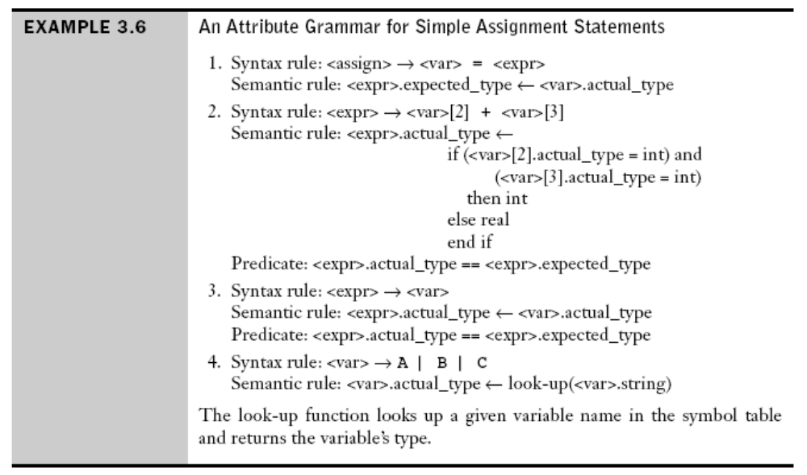
Attribute Grammars: Just To Show What It Is
3-<number>

Slide 34
Static Semantics
Indirectly related to the meaning of programs during execution
Context-free grammars (CFGs) cannot describe all of the syntax of programming languages
So named because the analysis required to check these specifications can be done at compile time
Attribute grammar is one formal approach to describing and checking the correctness of static semantics rules of a program
Copyright © 2015 Pearson. All rights reserved.
1-<number>

Slide 35
Static Semantics
Categories of constructs that are trouble:
- Context-free, but cumbersome (e.g.,
types of operands in expressions)
  1. Example in Java: floating point value cannot be
  assigned to an integer type variable but the
  opposite is legal
    This is difficult, requires additional non-terminal
    symbols and rules
- Non-context-free (e.g., variables must be declared before
they are used)
1. This rule cannot be specified in BNF
Copyright © 2015 Pearson. All rights reserved.
1-<number>

Slide 36
Attribute Grammars : Definition
Attribute Grammars are context-free grammars with added
Attributes: associated with grammar symbol
  - For each grammar symbol x there is a set A(x)
  of attribute values
Attribute computation functions (semantic functions): associated with grammar rules, used to specify how to compute attribute values
  - Each rule has a set of functions that define
  certain attributes of the nonterminals in the rule
Copyright © 2015 Pearson. All rights reserved.
1-<number>

Slide 37
Attribute Grammars : Definition
Attribute Grammars are context-free grammars with added
3. Predicate functions: states the static semantic rules of the language are associated with grammar rules
  - Each rule has a (possibly empty) set of predicates to check for attribute consistency
Copyright © 2015 Pearson. All rights reserved.
1-<number>

Slide 38
Basic Concepts – Summed Up
Attribute grammars are context-free grammars to which have been added attributes, attribute computation functions and predicate functions.
Attributes are associated with grammar symbols (the terminal and nonterminal symbols), are similar to variables that they can have values assigned to them.
Attribute computation functions (also called semantic functions) are associated with grammar rules. They are used to specify how attribute values are computed.
Predicate functions, which state the static semantic rules of languages, are associated with grammar rules.
3-<number>

Slide 39
Attribute Grammars: Definition
Let X₀ → X₁ ... X_{n} be a rule
Functions of the form S(X₀) = f(A(X₁), ... , A(X_{n})) define synthesized attributes
Functions of the form I(X_{j}) = f(A(X₀), ... , A(X_{n})), for i <= j <= n, define inherited attributes
Initially, there are intrinsic attributes on the leaves
Intrinsic attributes are synthesized attributes of leaf nodes whose values are determined outside the parse tree. For example, the type of an instance of a variable in a program could come from the symbol table, which is used to store variable names and their types.
Copyright © 2015 Pearson. All rights reserved.
1-<number>

Slide 40
Attribute Grammars Defined – just another view
X: grammar symbol
A(X): a set of attributes associated to X. A(X) consists of two disjoint sets S(X) and I(X).
S(X): Synthesized attributes, are used to pass semantic information up a parse tree.
I(X): Inherited attributes, are used to pass semantic information down and across a parse tree.
Let X₀ → X₁ ... X_{n} be a rule.
Functions of the form S(X₀) = f(A(X₁), ... , A(X_{n})) define synthesized attributes of X₀. The value of a synthesized attribute on a parse tree node depends only on that node’s children node.
Functions of the form I(X_{j}) = f(A(X₀), ... , A(X_{n})), for 1 <= j <= n, define inherited attributes. The value of a inherited attribute on a parse tree node depends only on that node’s parent node, and those of its sibling nodes.
3-<number>

Slide 41
Attribute Grammars: An Example
Syntax – small example
  <assign> -> <var> = <expr>
  <expr> -> <var> + <var> | <var>
  <var> A | B | C
actual_type: synthesized for <var> and <expr>
expected_type: inherited for <expr>
Copyright © 2015 Pearson. All rights reserved.
1-<number>

Slide 42
Rules For Example:
The attributes for the nonterminals in the example attribute grammar are:
• actual_type—A synthesized attribute associated with the nonterminals <var> and <expr>. It is used to store the actual type, int or real, of a variable or expression. In the case of a variable, the actual type is intrinsic. In the case of an expression, it is determined from the actual types of the child node or children nodes of the <expr> nonterminal.
• expected_type—An inherited attribute associated with the nonterminal <expr>. It is used to store the type, either int or real, that is expected for the expression, as determined by the type of the variable on the left side of the assignment statement.
Copyright © 2015 Pearson. All rights reserved.
1-<number>

Slide 43
Attribute Grammars: An Example
3-<number>

Slide 44
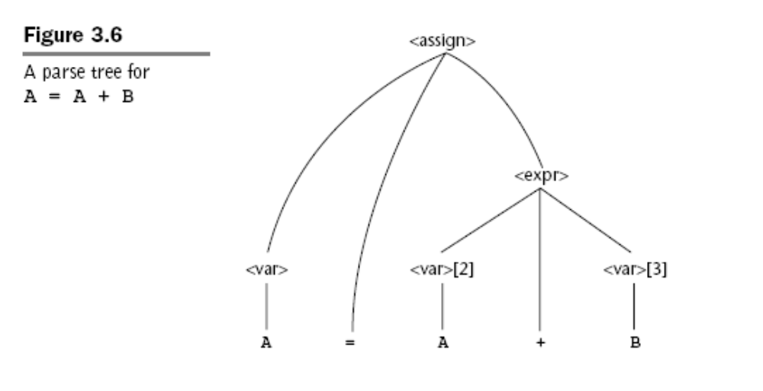
Attribute Grammars: An Example (cont’d)
3-<number>

Slide 45
Attribute Grammars (continued)
Computing the attribute values of a parse tree is sometimes called decorating the parse tree.
How are attribute values computed?
  If all attributes were inherited, the tree could be decorated in top-down order.
  If all attributes were synthesized, the tree could be decorated in bottom-up order.
  In many cases, both kinds of attributes are used, and it is some combination of top-down and bottom-up that must be used.
3-<number>

Slide 46
Attribute Grammars (continued)
Process to calculate attributes:
<var>.actual_type ← look-up(A) (Rule 4)
<expr>.expected_type ← <var>.actual_type (Rule 1)
<var>[2].actual_type ← lookup(A) (Rule 4)
<var>[3].actual_type ← lookup(B) (Rule 4)
<expr>.actual_type ← either int or real (Rule 2)
<expr>.expected_type == <expr>.actual is either TRUE or FALSE (Rule 2)
3-<number>

Slide 47
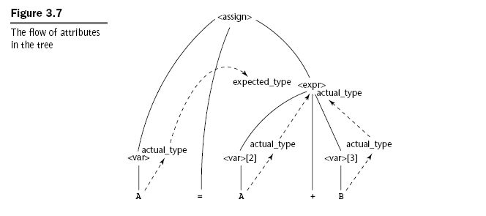
Attribute Grammars (continued)
Note: #2, is inherited, so #1 is acting as a Parent type, and not a Child type like #3.
3-<number>

Slide 48
Attribute Grammars (continued)
So is the type step 1 synthesized?
Is the expected type at #2, synthesized?
Is the actual type at #4 synthesized?
3-<number>

Slide 49
Attribute Grammars (continued)
<expr>.expected_type ← inherited from parent
<var>[1].actual_type ← lookup (A)
<var>[2].actual_type ← lookup (B)
<var>[1].actual_type =? <var>[2].actual_type
<expr>.actual_type ← <var>[1].actual_type
<expr>.actual_type =? <expr>.expected_type
Copyright © 2015 Pearson. All rights reserved.
1-<number>

Slide 50
Evaluation
Checking the static semantic rules of a language is an essential part of all compilers.
Even if a compiler writer has never heard of an attribute grammar, he or she would need to use their fundamental ideas to design the checks of static semantics rules for his or her compiler.
Copyright © 2015 Pearson. All rights reserved.
1-<number>

Slide 51
Evaluation
One of the main difficulties in using an attribute grammar to describe all of the syntax and static semantics of a real contemporary programming language is the size and complexity of the attribute grammar. The large number of attributes and semantic rules required for a complete programming language make such grammars difficult to write and read.
Copyright © 2015 Pearson. All rights reserved.
1-<number>

Slide 52
Semantics : Section 3.5
There is no single widely acceptable notation or formalism for describing semantics (thus we will not study 3.5)
Several needs for a methodology and notation for semantics:
  Programmers need to know what statements mean
  Compiler writers must know exactly what language constructs do
  Correctness proofs would be possible
  Compiler generators would be possible
  Designers could detect ambiguities and inconsistencies
Copyright © 2015 Pearson. All rights reserved.
1-<number>

Slide 53
Summary
BNF and context-free grammars are equivalent meta-languages
  Well-suited for describing the syntax of programming languages
An attribute grammar is a descriptive formalism that can describe both the syntax and the semantics of a language
(BNF does not handle all programming
semantics well)
Copyright © 2015 Pearson. All rights reserved.
1-<number>

Slide 54
Attribute Grammar (continued)
Syntax rule: <expr> → <var>[1] + <var>[2]
Semantic rules:
<expr>.actual_type ← <var>[1].actual_type
Predicate:
<var>[1].actual_type == <var>[2].actual_type
<expr>.expected_type == <expr>.actual_type
Syntax rule: <var> → id
Semantic rule:
<var>.actual_type ← lookup (<var>.string)
Copyright © 2015 Pearson. All rights reserved.
1-<number>

